Slide 1


Software Testing & Quality Assurance Activity (Technology Exploration)
Topic: GPT-5
Guided By:
Dr. Amit Welekar
Made By:
Arya Thool (BT230019CS)
Kajal Khandekar (BT230048CS)
Arya Surkar (BT230020CS)
Abhishek Gupta (BT230004CS)

Slide 2
Earlier Systems and Their Limitations
Earlier models such as GPT-3 and GPT-4 had already demonstrated significant progress in AI:
GPT-3 primarily focused on advanced text generation, enabling applications such as question answering, content summarization, and basic coding assistance.
GPT-4 improved reasoning accuracy and introduced multimodal capabilities, allowing the model to process both text and images.
However, these earlier systems still faced several limitations:
Users often had to choose between fast responses and deeper reasoning models.
Complex questions sometimes produced shallow or incomplete answers.
Reliability and factual consistency remained challenging for open-ended tasks.
Difficulty handling multi-step or highly complex problems.
These limitations created the need for a more advanced system that could combine speed, reasoning, and reliability within a single model.

Slide 3
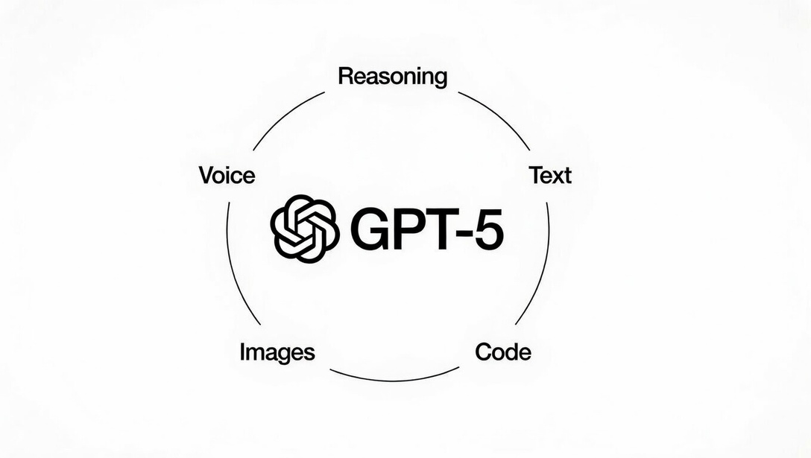
Introduction to GPT-5
GPT-5 is a newly introduced large-scale artificial intelligence model developed by OpenAI. It is designed as a general-purpose AI system that can understand, reason, and generate information across multiple types of inputs such as text, images, and voice.
Key characteristics of GPT-5:
Built with reasoning as a core capability, not an optional feature
Automatically applies deeper thinking for complex tasks
Combines speed, intelligence, and reliability in a single model
Designed for learning, coding, creative work, and professional use

Slide 4
Key Improvements Over Previous Models
1. Built-in Reasoning: Reasoning is now a core feature, not a separate mode. The model pauses and thinks when a task is complex, then delivers a structured response.
2. Coding Performance: GPT-5 is state-of-the-art across key coding benchmarks, scoring 74.9% on SWE-bench Verified and 88% on Aider Polyglot. It can build complete applications, debug code, and handle multi-step engineering tasks.
3. Multimodal Capability: Integrated text, image, and voice understanding are now available through a single interface, with video frame analysis capabilities and enhanced visual reasoning.
4. Reduced Hallucinations: With web search enabled, GPT-5's responses are ~45% less likely to contain a factual error than GPT-4o, and when thinking, approximately 80% less likely to contain a factual error than OpenAI o3.
5. Safe Completions: Instead of hard refusals, GPT-5 implements a "Safe Completions" approach — providing helpful responses within safety boundaries.

Slide 5
Applications and Usage of GPT-5
Domain | How GPT-5 is Applied
Education | Explains concepts via voice, generates interactive simulations (e.g., Bernoulli effect demo)
Software Development | Builds full applications, debugs code, handles multi-step coding tasks
Healthcare | Interprets medical documents, supports clinical reasoning, reduces hallucinations in health queries
Enterprise | Automates complex workflows, assists drug discovery, analyzes data at scale
Research & Analysis | Summarizes large volumes of scientific literature, assists in data interpretation and report generation

Slide 6
Impact and Conclusion
Impact of GPT-5:
Eliminated the Speed vs. Reasoning Trade-off.
Raised the Bar on Benchmark Performance.
Significantly Reduced Hallucinations.
Real-World Enterprise Impact.
Broadened Access to Advanced AI.
Conclusion:
GPT-5 demonstrates how modern AI systems are evolving into versatile tools that can support a wide range of real-world tasks. By combining advanced reasoning, multimodal interaction, and improved reliability, it enables practical applications across education, software development, healthcare, business, and research, highlighting the role of AI in enhancing productivity, learning, and decision-making.

Slide 7


YouTube Video Link:
https://www.youtube.com/live/0Uu_VJeVVfo?si=mGxC62YpJw_WZTkA

Slide 8
Thank You!

